Slide 1
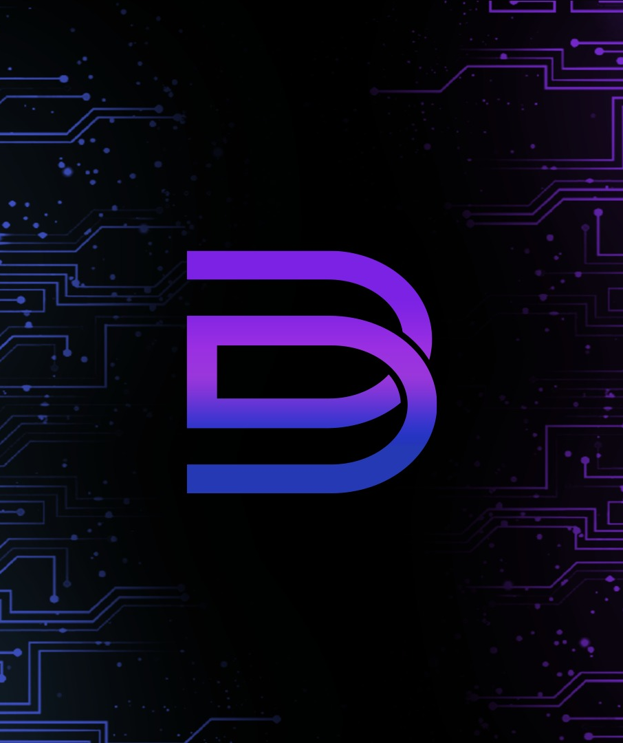

OBD
A I S O L U T I O N S
PROJECT KICKOFF · GFX-T
GFX-T, your website
is almost ready to launch.
All 7 pages are built and getting their final touches. Next, we put it live on your own domain with professional email and look after it once it's live.
Build. Launch. Care.
PREPARED FOR
PRESENTED BY
DATE
AI Solutions · MVP Development · Web Engineering
GFX-T, Lahore
Omer Bin Dawood
25 September 2026

Slide 2
OBD
WHO WE ARE
A I S O L U T I O N S
01 · OBD AI SOLUTIONS
An engineering studio built on AI.
We design and ship AI products, MVPs and production web platforms for founders and growing businesses, working with clients in the United States, Australia and Pakistan.
01
AI Solutions
Intelligent automation, LLM assistants and data workflows.
02
MVP Development
10+
25+
3
Idea to investor-ready product, on foundations that scale.
US & Australian
clients served
Businesses served
in Pakistan
Countries
US · AU · PK
03
Web Engineering
Fast, secure websites with infrastructure, email and support.
← Your project
OBD AI Solutions · OBD-GFXT-2026
02 / 13

Slide 3
OBD
EXPERIENCE
A I S O L U T I O N S
02 · TRACK RECORD
The teams we've built with.
Aginit
LEASAP
Marketing Transformers
DevNeuron
CA, USA
AUSTRALIA
CA, USA
…plus 25+ local businesses across Pakistan.
Founder-led
Documented
Transparent
Yours
Omer oversees every launch
Scope, fees & support in writing
No markups on third-party costs
Everything registered to you
OBD AI Solutions · OBD-GFXT-2026
03 / 13

Slide 4
OBD
YOUR TEAM
A I S O L U T I O N S
03 · WHO YOU'LL WORK WITH
Your project team.
OBD
PROJECT LEAD
H
ACCOUNT MANAGER
Omer Bin Dawood
Hira
CEO & Founder, OBD AI Solutions
AI Engineer, DevNeuron (CA, USA)
Client relations, OBD AI Solutions
Owns technical decisions, setup, configuration and launch. Your escalation point for anything critical.
Your day-to-day contact for scheduling, documents, billing and updates.
OBD AI Solutions · OBD-GFXT-2026
04 / 13

Slide 5
OBD
YOUR WEBSITE
A I S O L U T I O N S
04 · GFX-T WEBSITE
Built from your content. Almost ready.
PAGE 01
PAGE 02
PAGE 03
PAGE 04
Home
About Us
Services
Portfolio
PAGE 05
PAGE 06
PAGE 07
STATUS
Clients
Our Management
Contact Us
Almost ready
RECEIVED FROM YOU, THANK YOU
✓
CEO & COO photos for the Management page
All content is in.
We're adding the final touches now, and the site will be ready for your review shortly.
✓
Client logos for the Clients page
✓
Portfolio images
OBD AI Solutions · OBD-GFXT-2026
05 / 13

Slide 6
OBD
LAUNCH ROADMAP
A I S O L U T I O N S
05 · TIMELINE
Five working days to go live.
DAY 0
DAY 1–2
DAY 2–4
DAY 5
TO SEPTEMBER 2027
Onboard & sign
Domain & hosting
Deploy & configure
Review & go-live
Care period
Review pack, onboarding form, agreement, first instalment.
Guided purchase, in your name, on a short call.
Production deploy, DNS, SSL, email and devices.
Final review, launch, walkthrough and handover.
Support & maintenance, free minor changes in month one.
Launch quality checklist: HTTPS everywhere · mobile & browser tested · speed reviewed · SPF/DKIM/DMARC email · forms verified · backup handed over
OBD AI Solutions · OBD-GFXT-2026
06 / 13

Slide 7

OBD
A I S O L U T I O N S
06 · OUR OWNERSHIP PROMISE
Everything that runs your business online belongs to you.
Domain
Hosting
Email
Access
Registered in your name with your contact details.
Account and billing in your name, paid to the provider.
Mailboxes on your domain, with passwords that are yours.
Delegated for setup only. Revoke it at any time.
APPROX. THIRD-PARTY COSTS · PAID DIRECTLY BY YOU
approx. ~ PKR 3,000
approx. ~ PKR 7,000
0% commission.
We don't resell or mark up domains, hosting or email.
Domain (1 year)
Hosting (1 year)
07 / 13

Slide 8
OBD
YOUR INVESTMENT
A I S O L U T I O N S
07 · REFERRAL PRICING
Below our standard rates, by design.
Because you were referred by Isha (Wajeeha Baig), preferential rates apply to both development and deployment.
SERVICE
STANDARD
YOUR RATE
Website development
PKR 25,000
PKR 15,000
Almost ready, built from your content
Deployment · Complete Care
PKR 25,000
PKR 20,000
Option A · Recommended
Deployment · Launch Essentials
PKR 25,000
PKR 12,000
Option B
OBD AI Solutions · OBD-GFXT-2026
08 / 13

Slide 9
OBD
CHOOSE YOUR PACKAGE
A I S O L U T I O N S
08 · DEPLOYMENT OPTIONS
Choose how we look after you.
OPTION A
RECOMMENDED
OPTION B
Complete Care
Launch Essentials
PKR 20,000
PKR 12,000
Total with development: PKR 35,000
Total with development: PKR 27,000
✓
Domain & DNS setup
✓
Domain & DNS setup
✓
Hosting setup and website go-live
✓
Hosting setup and website go-live
✓
SSL (HTTPS) and security setup
✓
SSL (HTTPS) and security setup
✓
Professional email (e.g. info@gfxt.com)
✓
Bug fixes for 14 days after go-live
✓
Email set up on your phone and laptop
–
No email setup or yearly maintenance
✓
Support & maintenance until 30 September 2027
✓
Free minor UI/content changes for 30 days after launch
OBD AI Solutions · OBD-GFXT-2026
09 / 13

Slide 10
OBD
PAYMENT SCHEDULE
A I S O L U T I O N S
09 · WHEN YOU PAY
Two simple instalments.
01
02
INSTALMENT 1
INSTALMENT 2
On signing
On go-live
Development fee (100%)
+ deployment advance (50%)
Deployment balance (50%)
once your site is live
OPTION A · COMPLETE CARE
OPTION B · LAUNCH ESSENTIALS
OPTION A · COMPLETE CARE
OPTION B · LAUNCH ESSENTIALS
PKR 25,000
PKR 21,000
PKR 10,000
PKR 6,000
Bank transfer, Easypaisa, JazzCash or cash · A receipt for every payment · A signed agreement for both sides' records.
OBD AI Solutions · OBD-GFXT-2026
10 / 13

Slide 11
OBD
CARE & SUPPORT
A I S O L U T I O N S
10 · AFTER LAUNCH
Care that doesn't stop at go-live.
PRIORITY
EXAMPLE
FIRST RESPONSE
SUPPORTED UNTIL
30 September 2027
Critical
Website or email down
Same business day
High
Key page or form broken
Within 1 business day
Normal
Minor change or question
Within 1 business day
+ Free minor UI/content changes for the first 30 days.
Something we don't normally include. Complete Care package.
Channels: WhatsApp project group · Hira (account manager) · Omer Bin Dawood (escalations)
Hours: Monday–Saturday, 10:00–19:00 PKT
OBD AI Solutions · OBD-GFXT-2026
11 / 13

Slide 12
OBD
NEXT STEPS
A I S O L U T I O N S
11 · LET'S GET YOU LIVE
Four steps from here.
1
2
3
4
Review
Fill in
Sign
Launch
This deck and the Welcome Pack.
The short onboarding form: details, domain, email accounts.
Choose a package and sign the Service Agreement. Pay instalment 1.
Book the domain & hosting call. We go live within 5 working days.
YOUR ONBOARDING DOCUMENTS
01 Welcome Pack 02 Onboarding Form 03 Service Agreement 04 Go-Live & Handover
OBD AI Solutions · OBD-GFXT-2026
12 / 13

Slide 13

OBD
A I S O L U T I O N S
Thank you, GFX-T.
We Create. We Strategize. We Elevate. Let's give that promise a home online.
Omer Bin Dawood
CEO & Founder, OBD AI Solutions · AI Engineer, DevNeuron (CA, USA)

